Slide 1
Django
by :
Andik Al Fauzi
Happy Trianna
Andrew Sunanda
Mukhlish Rasyidi

Slide 2
An Overview of Django Web Framework
This presentation introduces the Django web framework, a versatile and flexible Python framework for web development. It covers its advantages, including its speed, admin interface, ecosystem of third-party packages, security, scalability, and versatility.

Slide 3
What is Django?
A web framework developed using Python.
Built on a Model-View-Template (MVT) concept to organize and design code with a good interface.
Ready-to-use, with a number of tools available for integration.

Slide 4
Advantages of Django
Fast and simple to use, with a few settings to tweak and add features.
Built-in admin interface for managing application data.
Vast ecosystem of third-party packages to extend functionality.
Highly secure and scalable, with caching mechanisms to improve performance.
Versatile for various types of websites, from simple web development to scientific computing platforms and machine learning models.

Slide 5
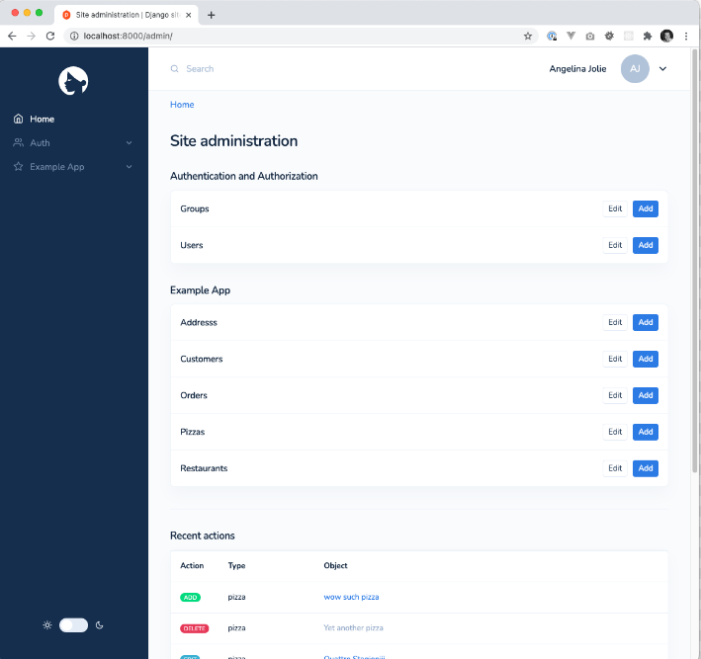
Django's Admin Interface
Built-in interface for managing application data.
Allows for common tasks like adding, updating, and deleting records from the database.

Slide 6
Django's Third-Party Packages
Vast ecosystem of third-party packages to extend functionality.
Can add features like authentication, social media integration, and payment processing to the application.

Slide 7

Django's Versatility
Can be used for various types of websites, from simple web development to scientific computing platforms and machine learning models.
Versatile framework for web development.

Slide 8
Examples of Django Applications
News websites, marketplaces, and content management systems.
Scientific computing platforms and machine learning models.

Slide 9
Django Conclusion
Flexible and versatile Python framework for web development.
High security and stability even with high traffic.
Provides easy access to database support and library.
Requires Python knowledge but allows for broad exploration of web development.

Slide 10
Thank you for your attention

